Slide 1
Device Communication using UART
EE272L Digital System Lab
Instructor: Miss Mahnoor Farhat
TEAM MEMBERS
Haiqua Ghaffar | 2024-EE-53
Hamza Khalid | 2024-EE-88
Abdul Rafay | 2024-EE-91

Slide 2
Outline
Introduction
Design
Implementation
Results
FPGA Demo
Conclusion
Q&A
1

Slide 3
Introduction
Problem Statement
Design a system that allows a PC to communicate with FPGA memory through UART.
Objectives
• Receive commands from PC using UART
• Buffer incoming and outgoing data using FIFOs
• Perform memory read/write operations
• Return responses to PC through UART
• Validate functionality on Nexys A7 FPGA
2

Slide 4
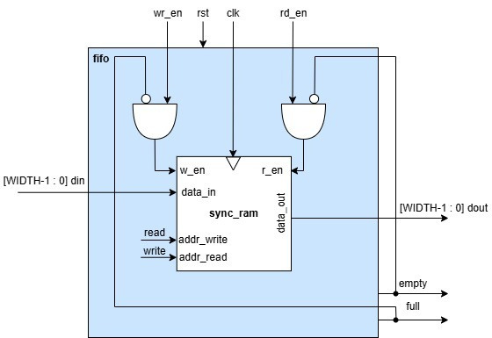
Design - FIFO
Features
• Ignores read when empty
• Ignores write when full
• Supports simultaneous read and write
• Uses a RAM module
• Fully Synchronous
• Parameterized with WIDTH and DEPTH
3

Slide 5
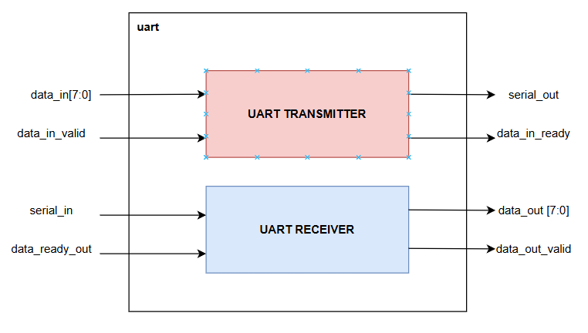
Design - UART
Features
• Baud Rate: 115200
• Two-wire interface: TX and RX
• Frame: 1 start bit, 8 data bits, 1 stop bit
• Used for FPGA-to-PC communication
• Uses Ready/Valid handshaking interface
4

Slide 6
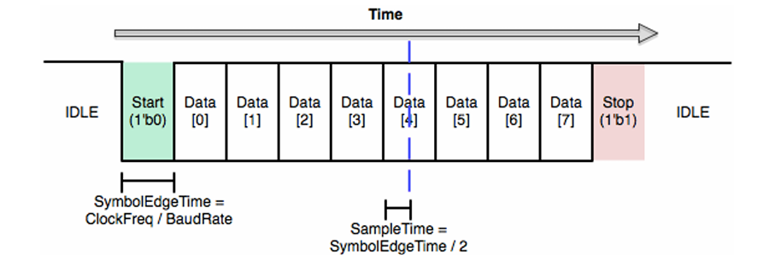
UART Transmitter
• Serializes 8-bit parallel data into a serial bitstream
• Packet: 1 Start bit (low) + 8 Data bits (LSB first) + 1 Stop bit (high)
• Controlled by an FSM (Idle, Trasmit States)
• Shift register outputs one bit per baud period
• Asserts data_in_ready when idle and ready for new data
UART Packet Framing
5

Slide 7
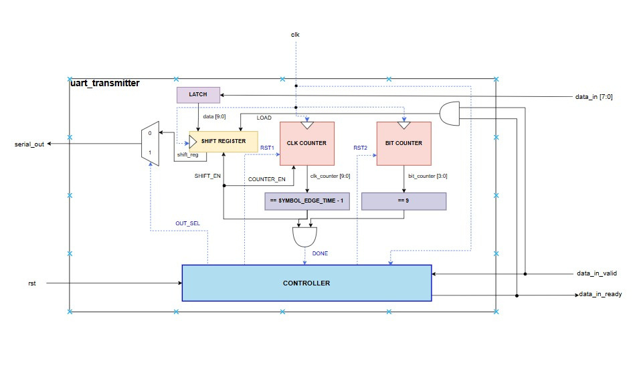
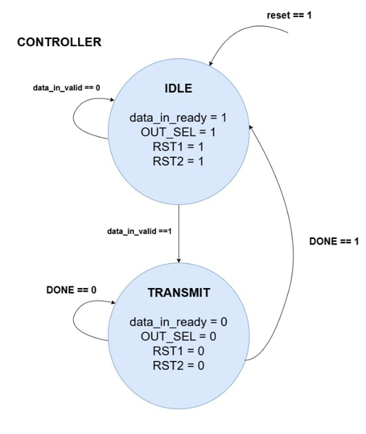
Block Diagram of UART Transmitter
State Transition Diagram
of the Controller
6

Slide 8
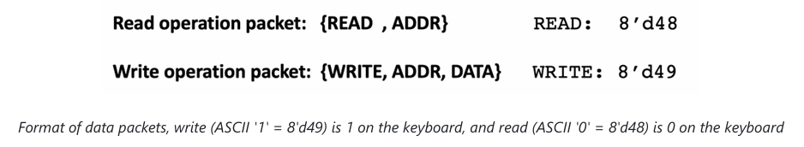
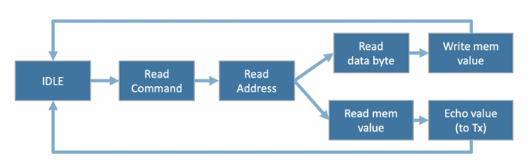
Design - Memory Controller
• Handles memory reads and writes based on commands from the host PC
• Host sends a 2-byte packet for Read, 3-byte packet for Write via UART
• Each operation is a multi-cycle process controlled by different states
Flow Diagram of Memory Controller
7

Slide 9
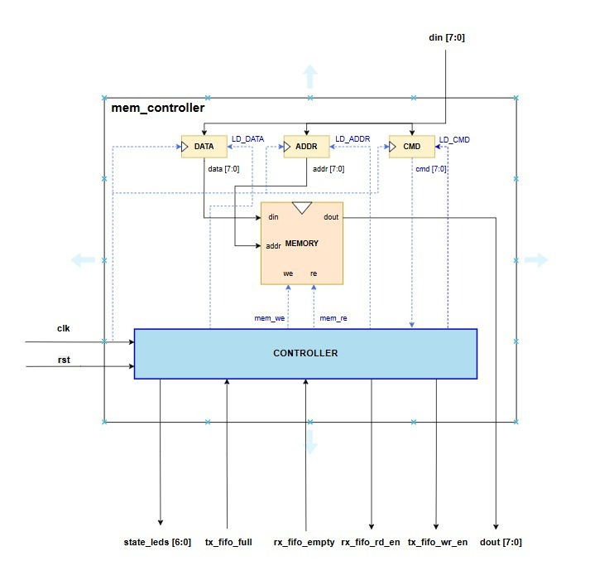
Block Diagram of Memory Controller
8

Slide 10
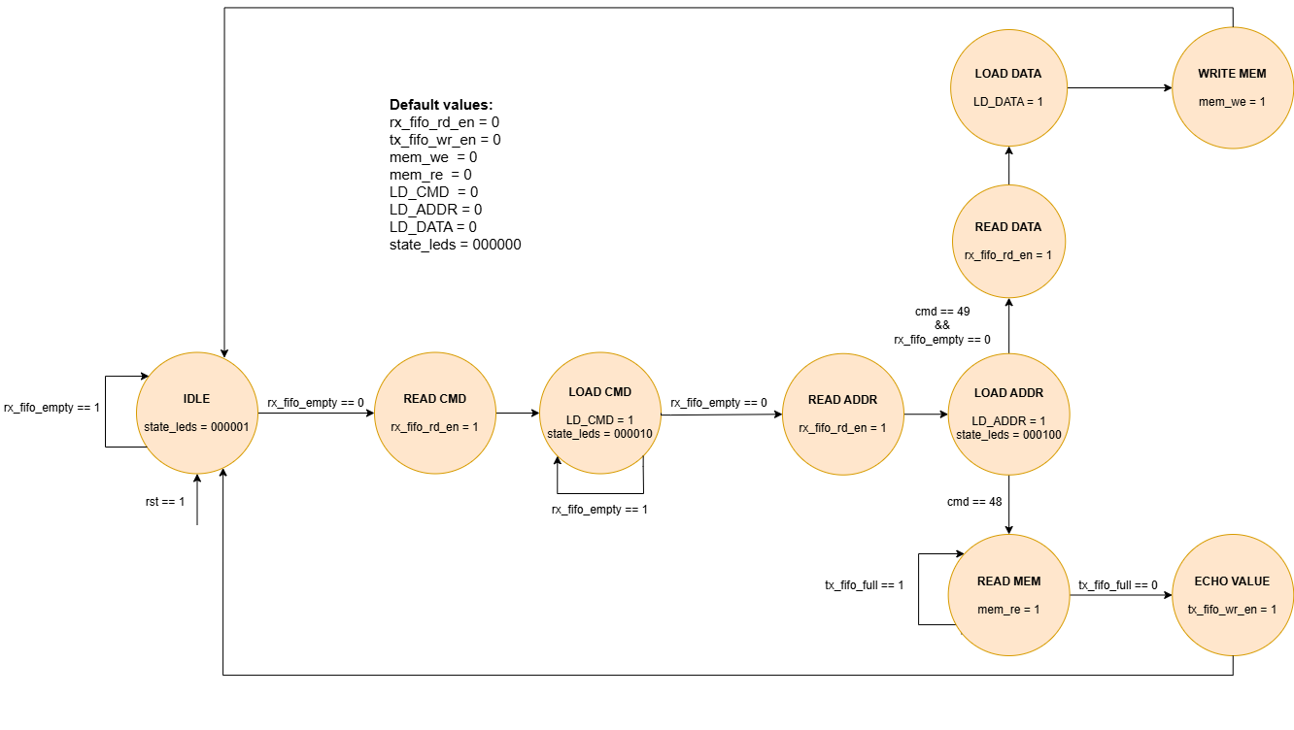
State Transition Diagram of Memory Controller
9

Slide 11
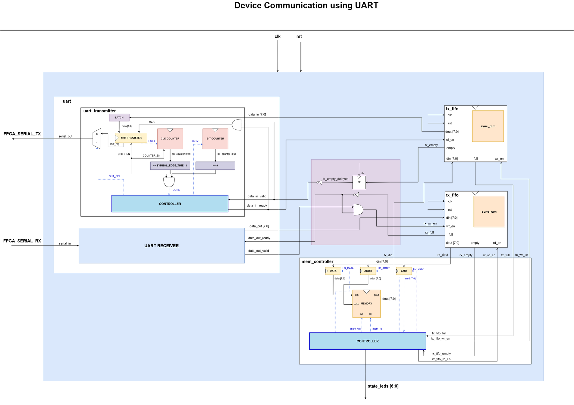
System Block Diagram
Block Diagram of the Complete System
10

Slide 12
Implementation
The complete system was designed and implemented in SystemVerilog. Below is the module hierarchy:
a7top
├── uart
│ ├── uart_transmitter
│ │ ├── datapath_uart
│ │ └── controller_uart
│ └── uart_receiver
├── tx_fifo
│ └── sync_ram
├── rx_fifo
│ └── sync_ram
└── mem_controller
├── memory
├── datapath_mem_ctrl
└── controller_mem_ctrl
11

Slide 13
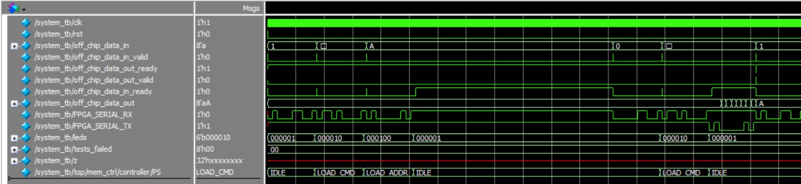
Results
All modules passed their simulation tests after simulating with the provided testbench files.
The functionality of the complete system was verified. The flow of information:
UART -> RX_FIFO -> Memory Controller -> Memory -> TX_FIFO -> UART
Simulation Results of the Complete System - Questa Sim
12

Slide 14
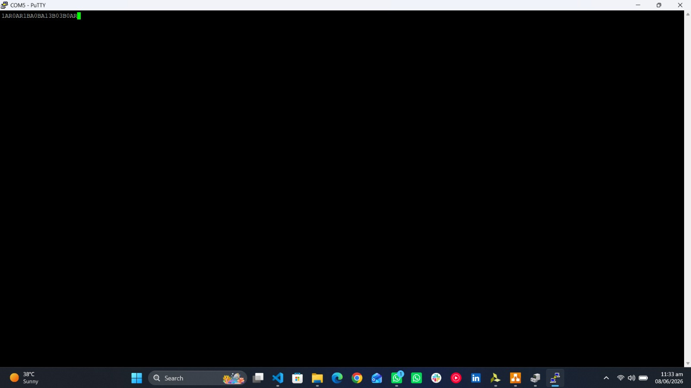
FPGA Demo
The system was synthesized using Xilinx Vivado and programmed onto the Nexys A7 FPGA.
The PuTTY terminal on the host PC was used to send and receive bytes to/from the FPGA over UART.
Multiple read and write packets were sent, and the read data was successfully received back from the FPGA.
PuTTY
USB-UART Bridge
UART
RX FIFO
Memory Controller
TX FIFO
UART
FPGA Demo - PuTTY Terminal
13

Slide 15
Conclusion
A complete UART-based device communication system was designed and implemented in SystemVerilog.
The system enables a host PC to read from and write to FPGA memory at 115200 baud, using FIFO buffers for flow control and reliable data transfer.
All modules were individually verified through simulation in Questa Sim, and the full system was validated both in simulation and on the Nexys A7 FPGA.
This project demonstrated device communication using UART, to interface between a host computer and a synchronous memory block.
14

Slide 16
Q&A
15

